Slide 1

Dive Buddy
Your diving school application

Slide 2

Genereal Overview of the application
If you ever wanted to dive in the ocean/sea, you first need to find a good diving school. After that, you must register for a diving course to become an Open water diver.
Until now, the instructors manage the students diving progress in some local notebooks, which is not so convenient.
So, we’ve created the perfect application for diving schools: Dive Buddy.
In Dive Buddy after each diving session, the student would submit his dive with the following information: depth, location, equipment, date, dive duration, and maybe some note to the instructor.

Slide 3
After that, the Instructor can instantly view the dive log of the student and choose to approve it or deny it with some additional remarks.
This feature will replace the old notebooks, and the option to lose some student dives information and generally make the student-instructor interaction more comfortable.
By that, both the student and the instructor don’t need to waste their time and can keep their focus on improving the diving experience and progress in receiving their first diving star.

Slide 4
Important to mention, our application focuses on the students of some diving schools, but also can be very helpful for experienced divers who wants just to be updated with the latest information about the diving school and to communicate with the school members.

Slide 5
Similar applications
Currently, in the market, there are several applications for diving experience, with some great features, but none of them are fulfilling our purpose: make the student-instructor interaction easier.
Diveboard – a diving application where you can upload pictures, the underwater species you’ve spotted, and the buddies you’ve divided with.
Dive Log – IOS app designed to work as a standalone scuba diving log app.
These applications are great for individual diving, but not for managing a diving school in particular.

Slide 6
Central requirements of the system
Some of the most relevant functional requirements of our system:
Register for new Student / Instructor.
Sign in for an already existing account.
Dive progress (Diving log) for the student.
Instructor can approve/decline student’s dive.
Forum for all the users, where they can communicate with each other and ask some relative questions.
School schedule: The instructor can add an event, such as a morning dive, group meeting, etc. And the Students can view the schedule in monthly, weekly, or day view options.

Slide 7
Central requirements of the system
Some of the most relevant non-functional requirements of the system:
You can use our application on several platforms: your mobile phone (IOS/Android) or via your browser.
The main page of the application includes 3 main fields: Dive log, Forum, and Schedule.
Very comfortable and intuitive filling of the diving log.

Slide 8
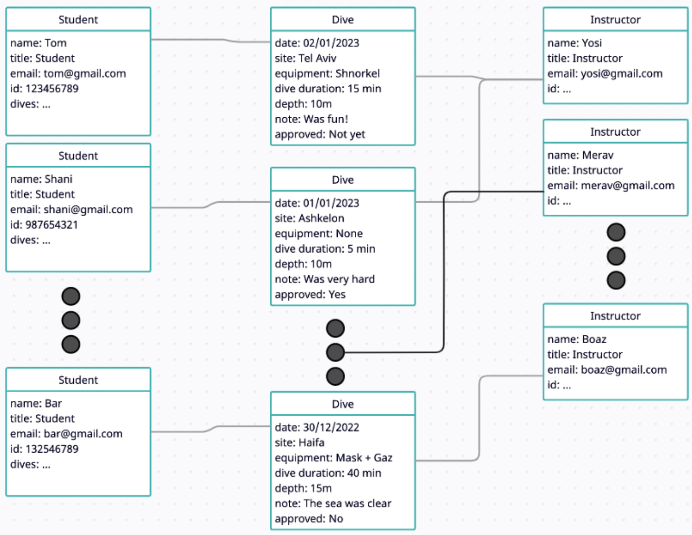
Some of the selected UML diagrams
Here you can see the Object Diagram of some of the students in our school, with their information that we received in the registration step.
Alongside some of the school instructors. After each student submits a dive log with the needed information, the Instructor can view the log and choose to approve or deny the student’s dive.

Slide 9
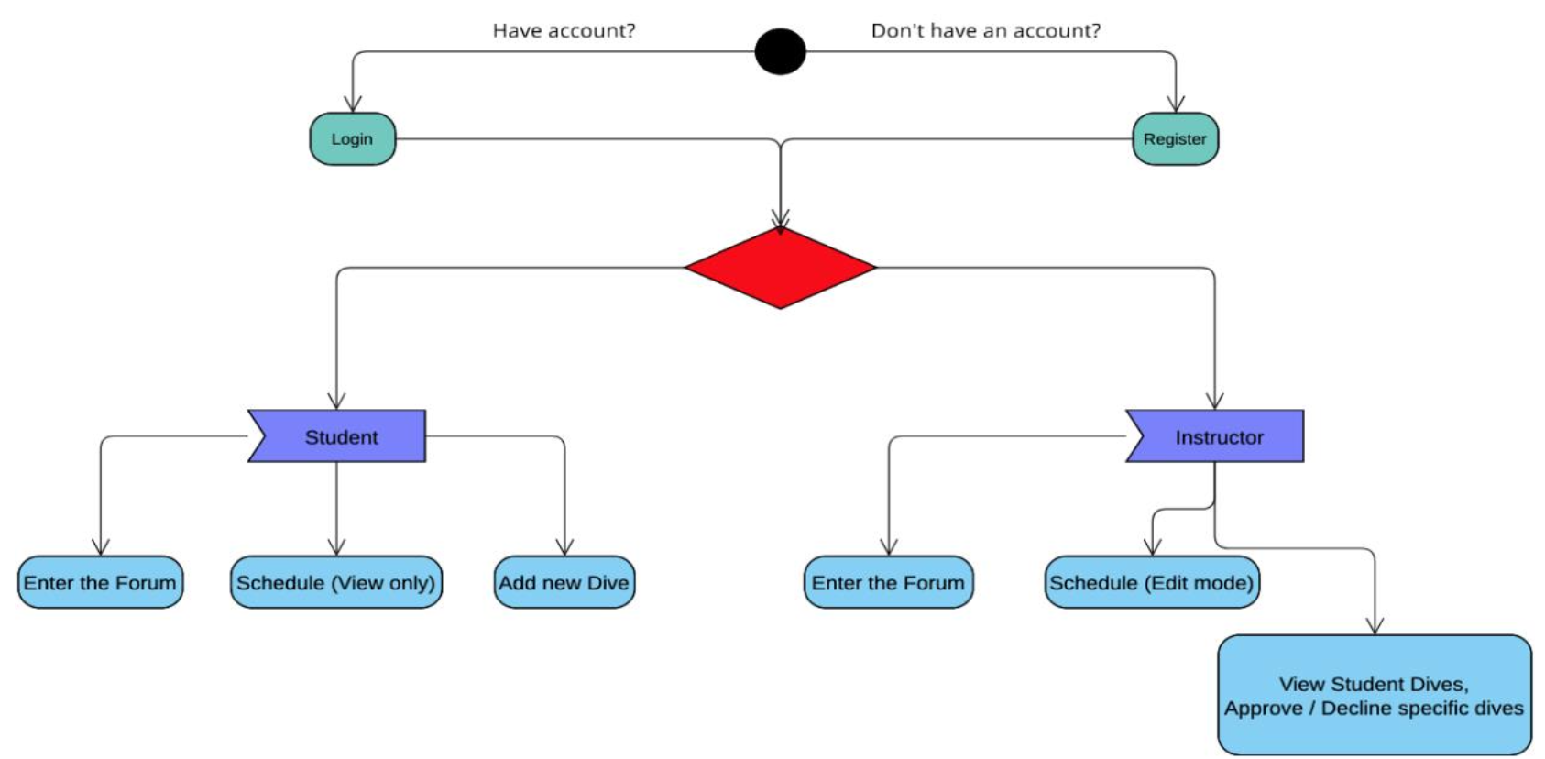
Some of the selected UML diagrams
Here you can see the Activity Diagram. In which the user can choose between Login / Register, and then proceed to our application features based on his role – Student or Instructor.

Slide 10
System description
In the next couple of slides, we will show you the main pages of our application and what each page stands for.

Slide 11
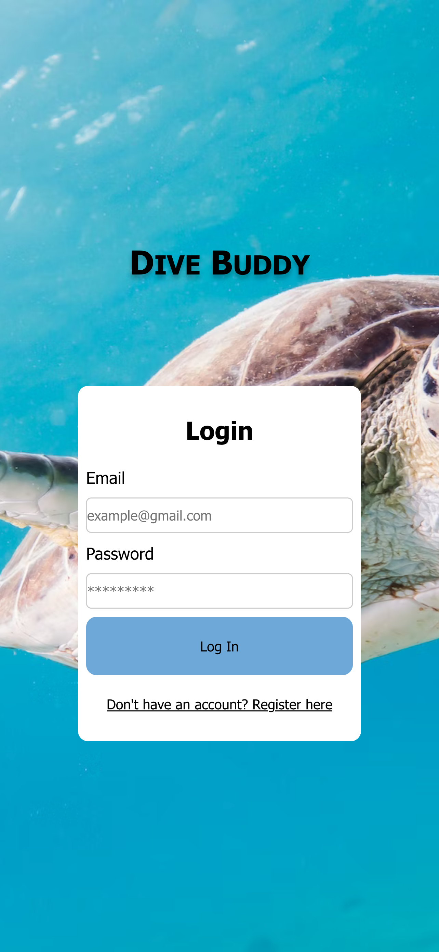
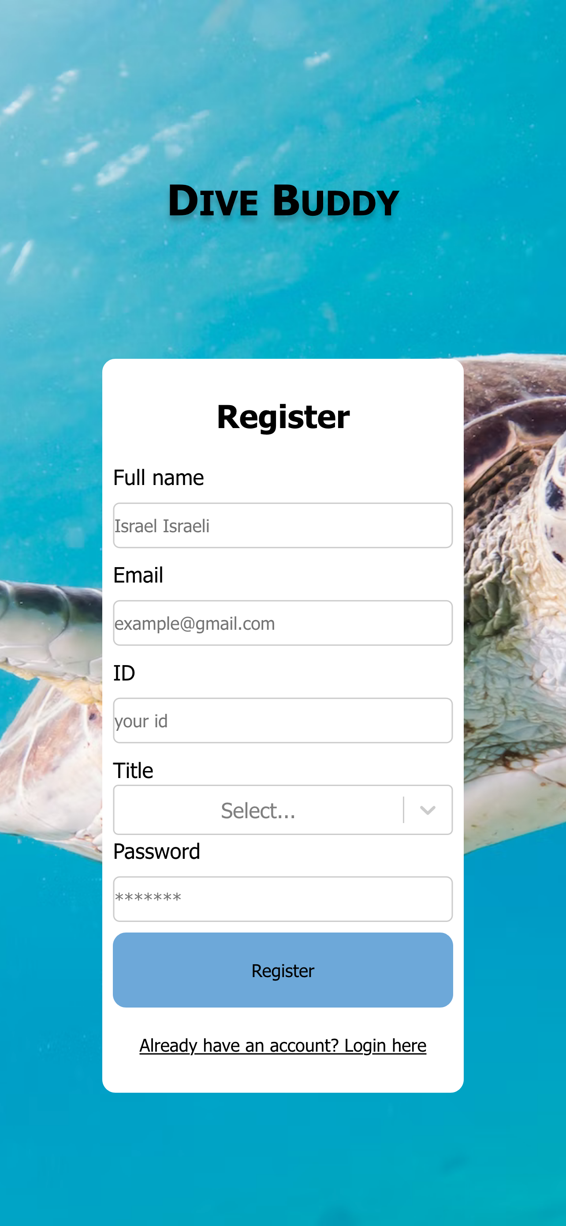
Login and Register
Here you can Login with existing account, and if you don’t have an account – just hit the ‘Register Here’ button
Here just fill in your basic information: name, email, id, title (instructor/student), and set a password
When you try to log in, we check the input in our database (Firebase). If there is a match -> you will be transferred inside.

Slide 12
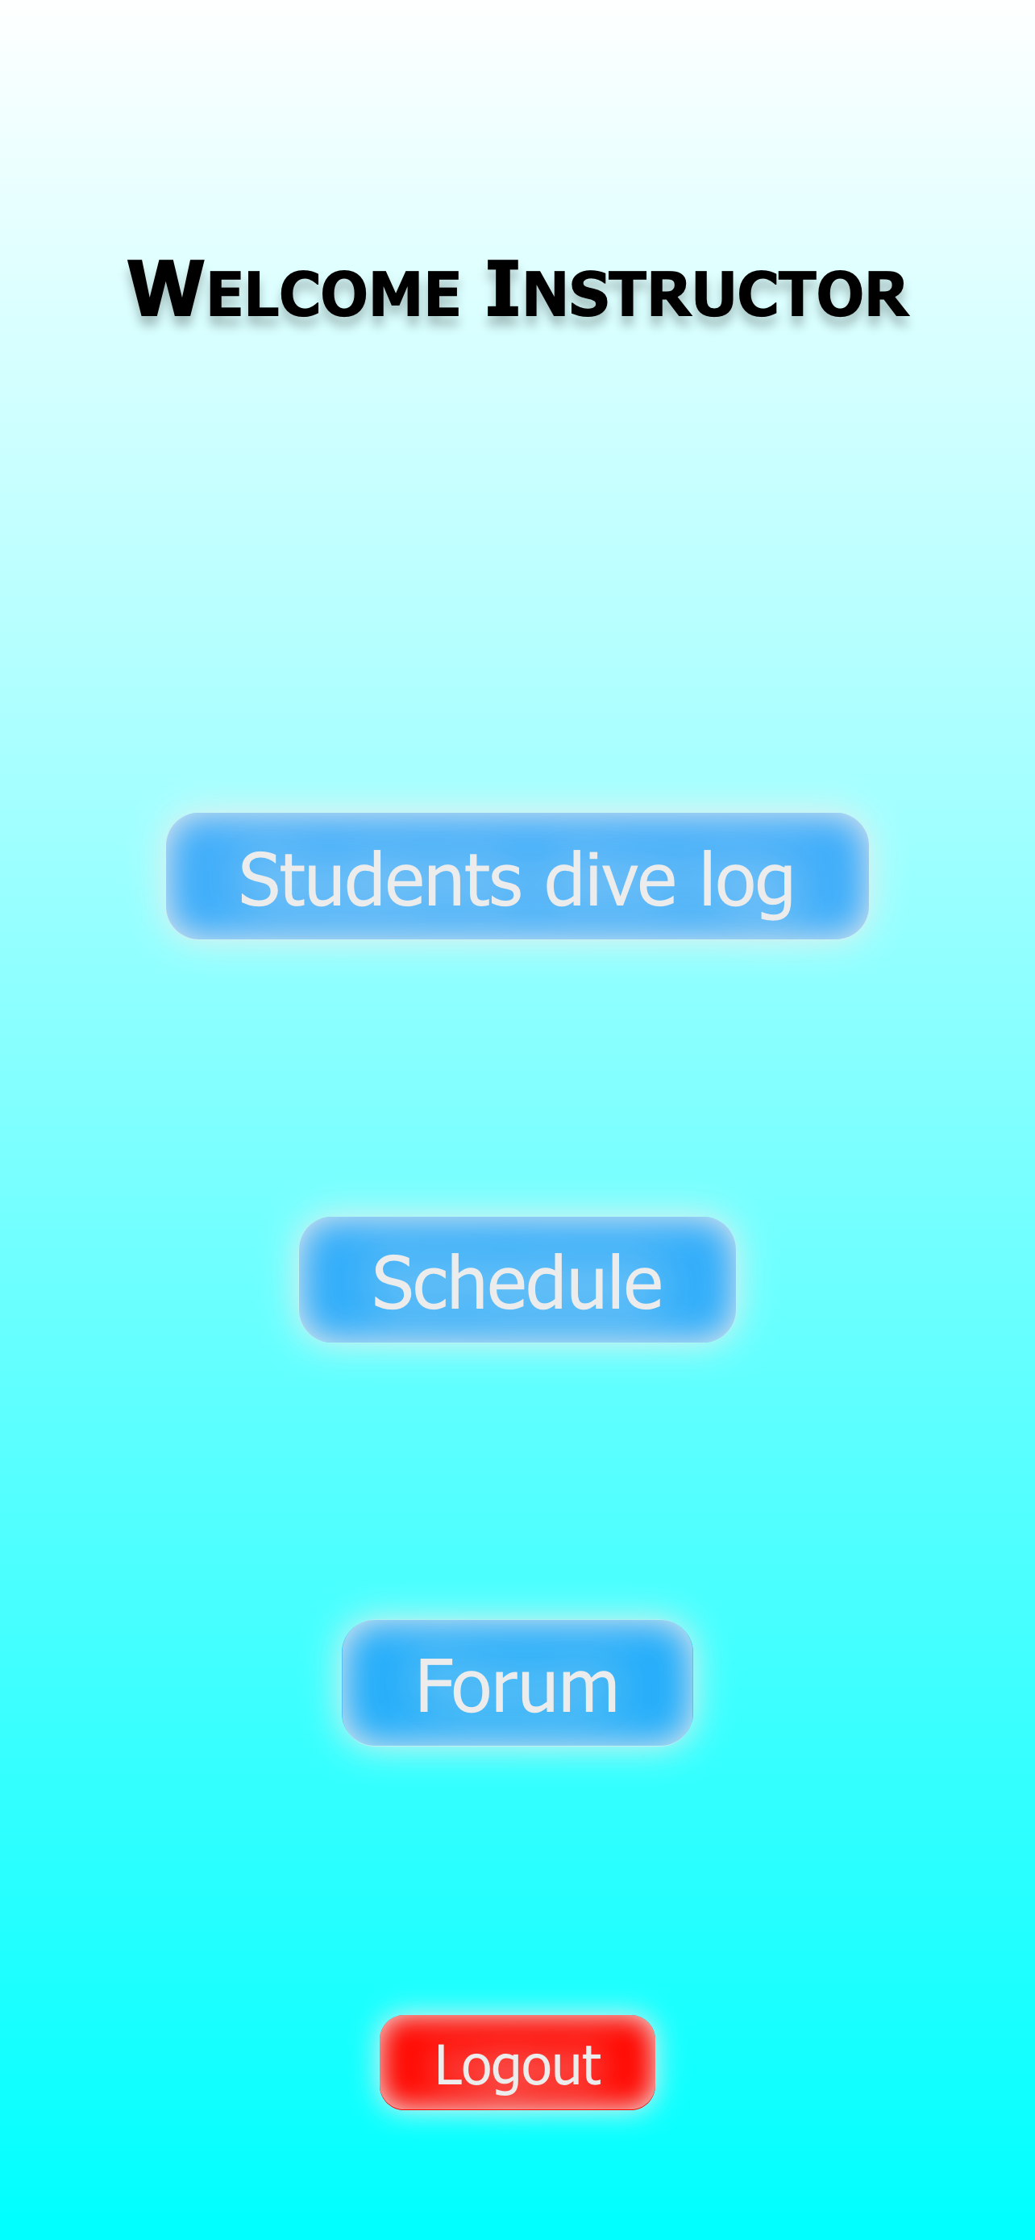
Instructor Page
Access to the students dive log
Access to the Schedule, where the instructor can add events
Access to the Forum, where the instructor can send and read messages from other dive school members
And of course, the logout button that sends you back to the login page

Slide 13
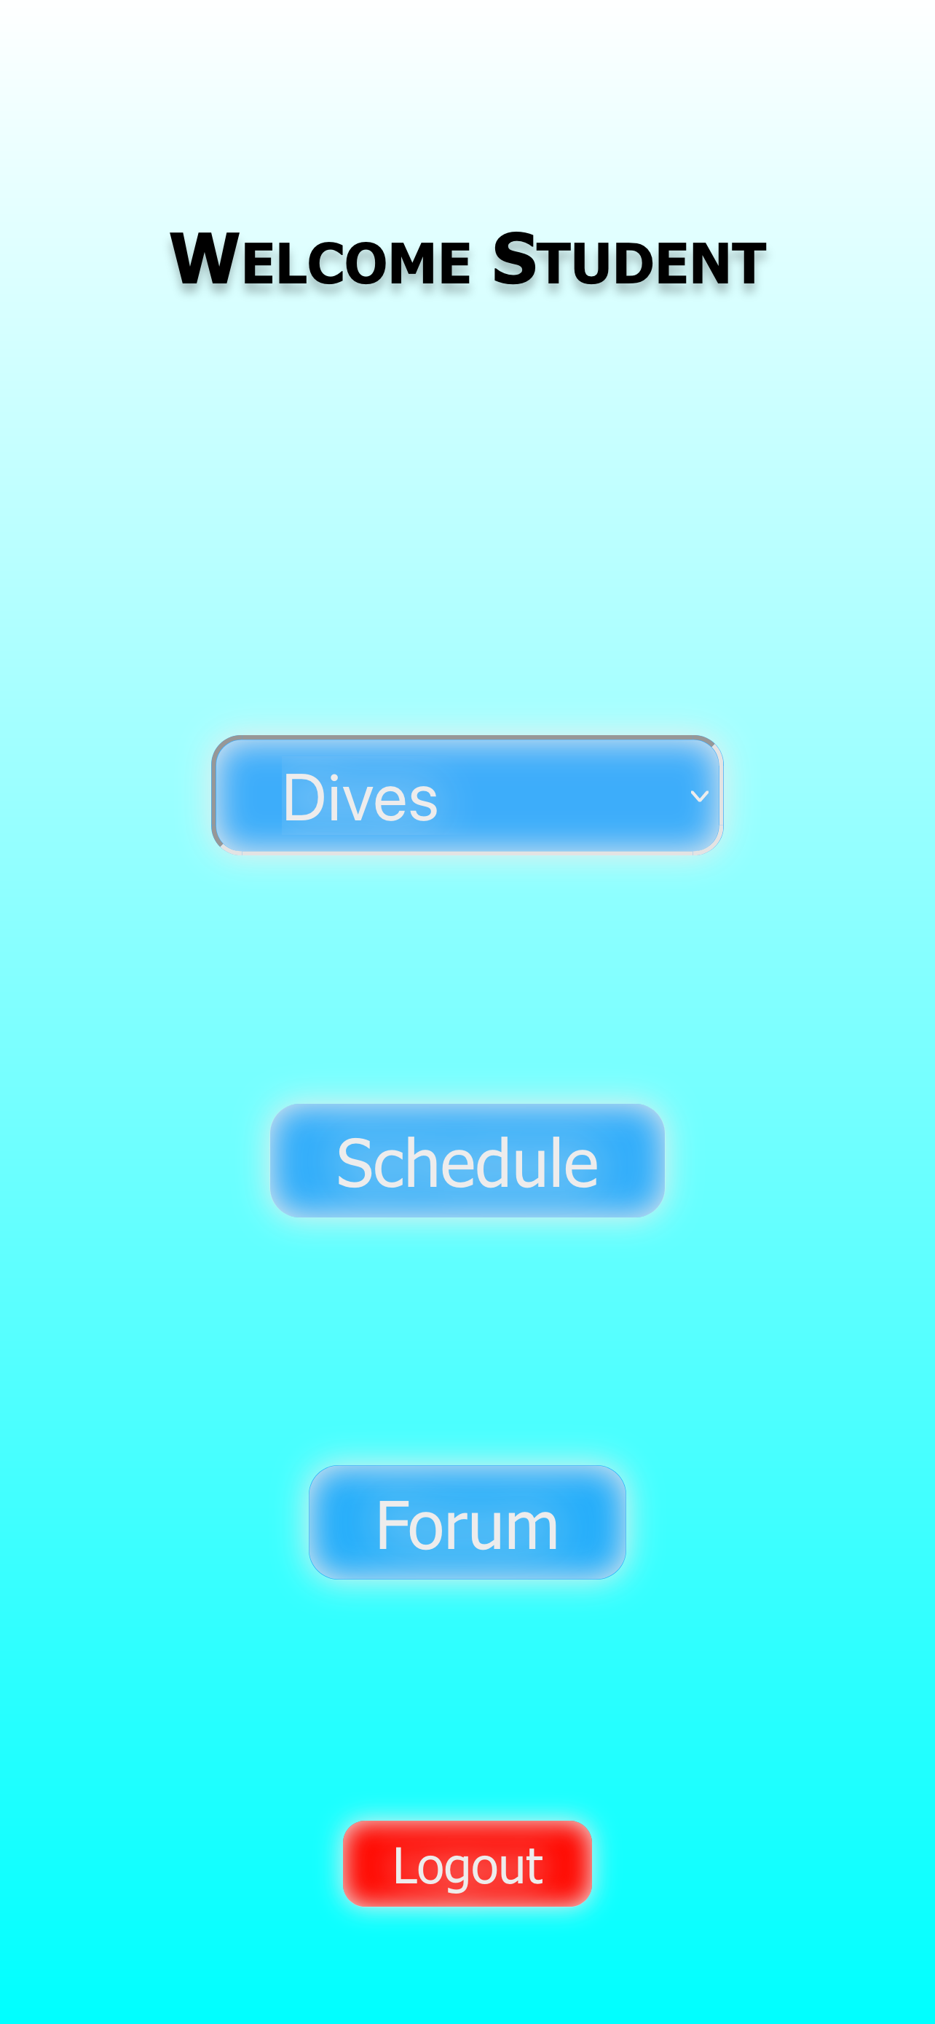
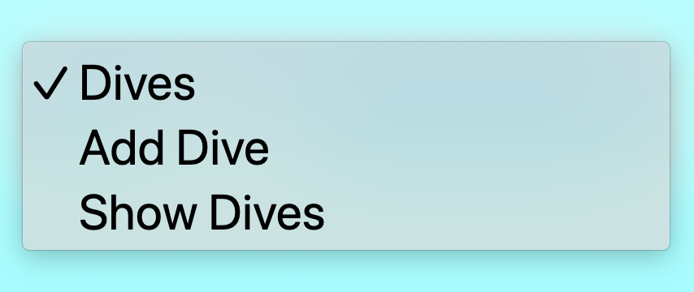
Student Page
Here the student can see the events that were submitted by the instructors.
Here the student can add a new dive or see his recent dive logs
The school forum, where the student can send and read messages that was sent by other school members
And of course the logout button that sends you back to the login page

Slide 14
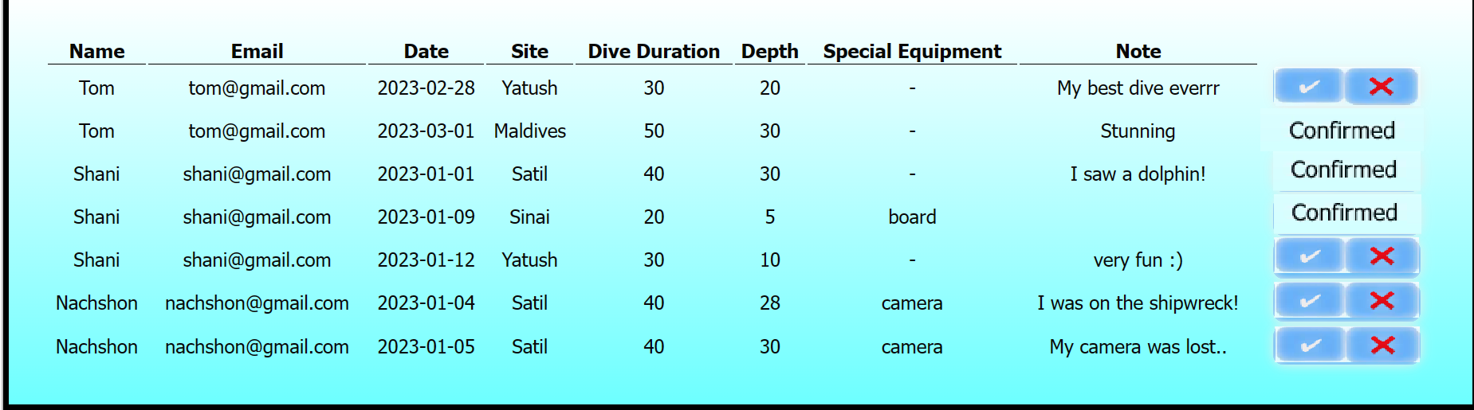
Instructor Page Students dive log
Here the instructor can confirm\decline the dive
The diving data filled in by the student

Slide 15
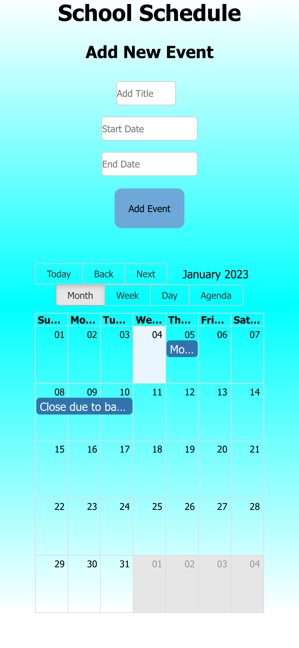
Schedule Instructor view
The instructor need to set the title of the event, the start and the end date of the event
Then, press the ‘Add Event’ button
Calendar view options: Month / Week / Day
After that, the event will appear in the calendar

Slide 16
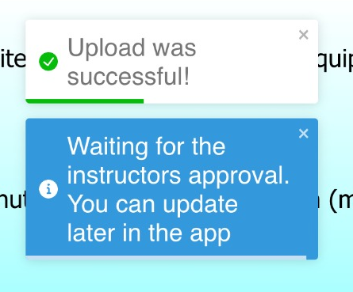
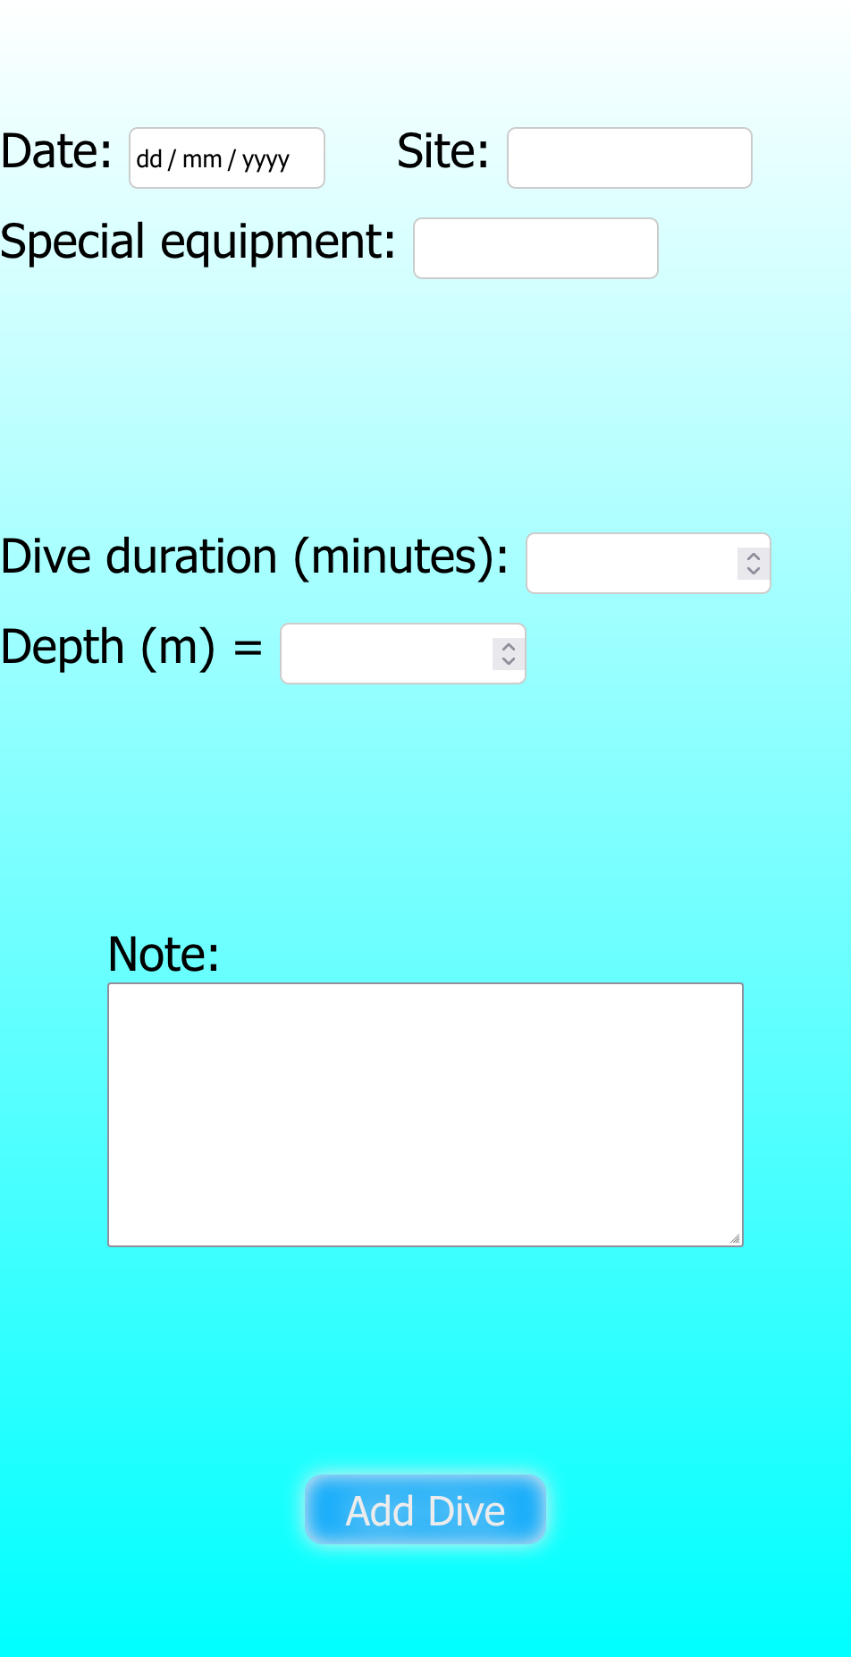
Add Dive Student view
The student need to provide all the displayed information in order to submit the dive log
After the student adds a dive, the app alerts him.
The note section are for leaving some remarks for the instructor to read them, so this section is optional
After filling all the information, just hit the ‘Add Dive’ button

Slide 17
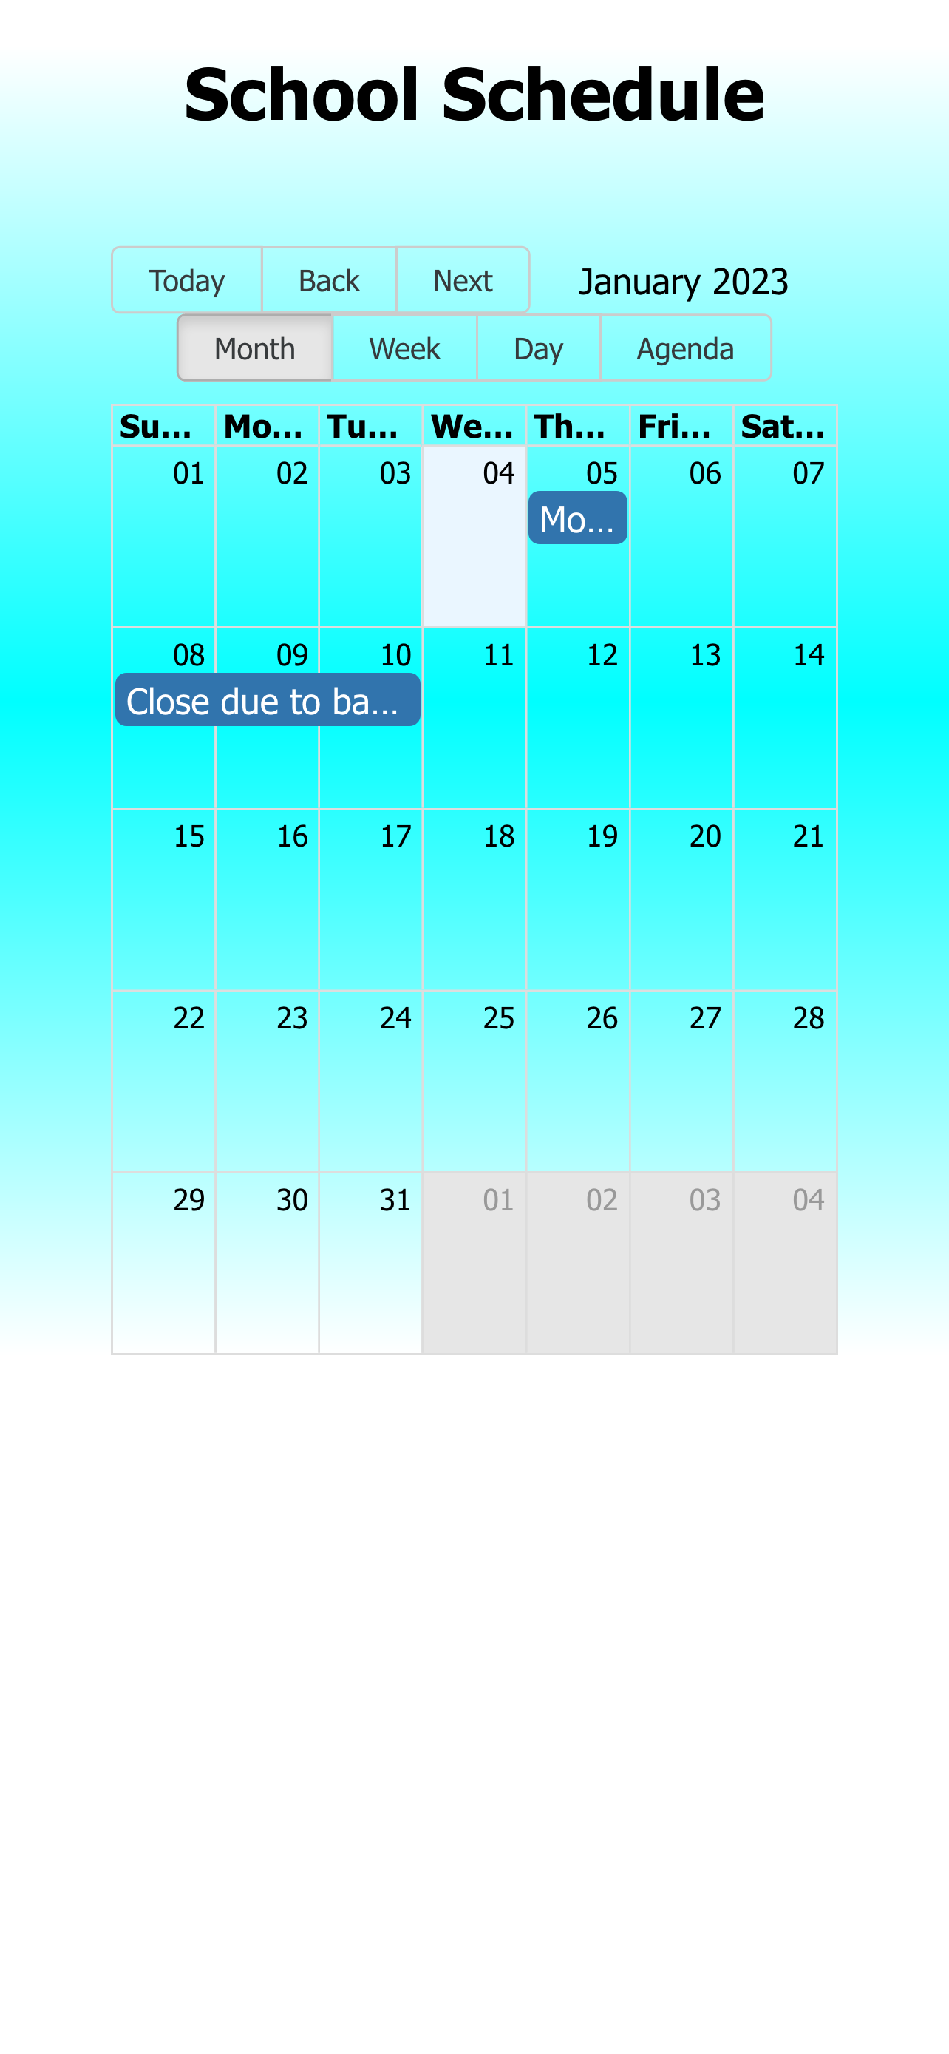
Schedule Student view
The student can see all the submitted events, but cannot add a new event.

Slide 18
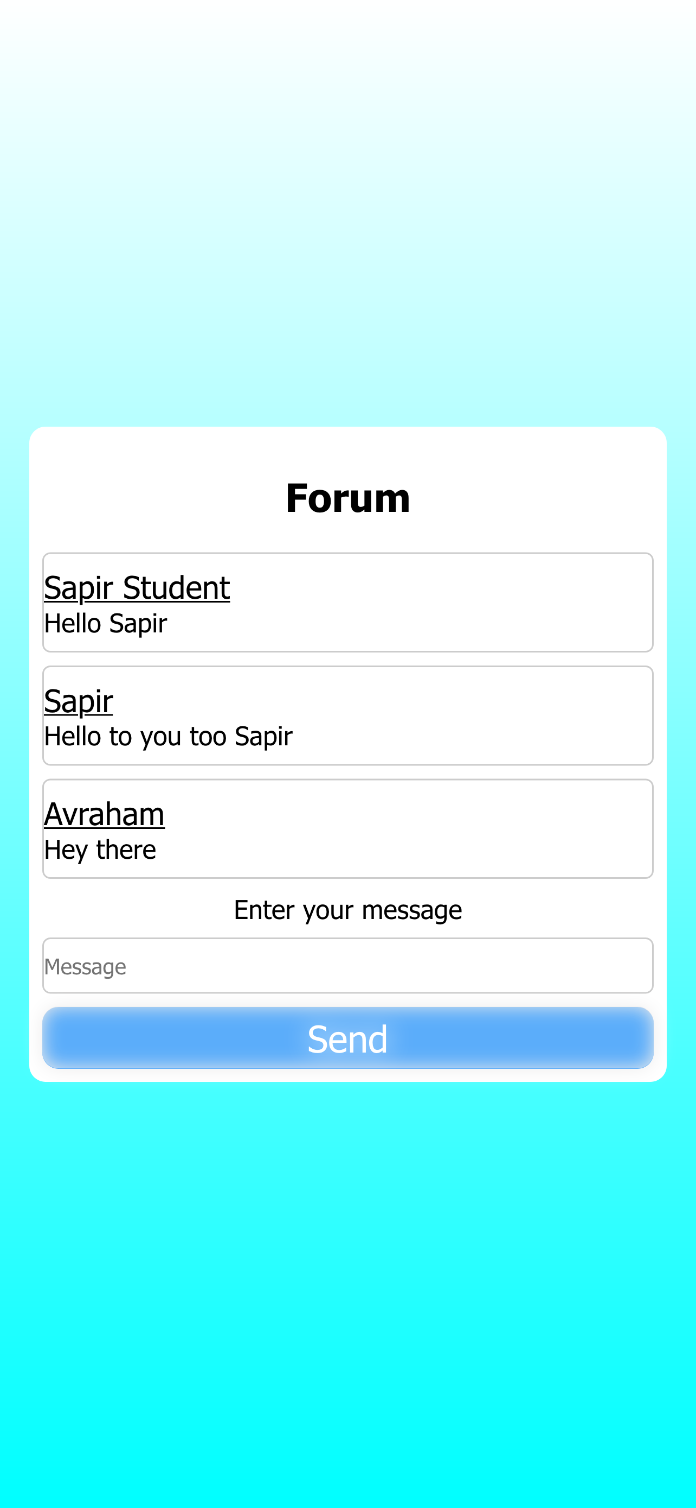
School Forum
Here are displayed all the previous messages from all the school members
To send a new message, just write something in the ‘Message’ box and press ‘Send’

Slide 19
Technological mapping
The application was written and designed via React Native. So basically, we combined JavaScript, HTML, and CSS. The logic and the brain of the application were written in JavaScript, while the styling was written in CSS. To store the data (user information, schedule events, …) the application connects to a server, then the server listens for the given port and communicates with the database (MongoDB), data extraction is also done through the server. All this server connection done through routes that are able to post,get information from the database.

Slide 20
Score Gaps
In the beginning, we’ve planned to include a short test for the students in order to complete the diving course. But we understood that in order to complete this task we needed to implement some ‘Moodle’ like consept, and we did not have the tools and the knoweldge to do so.
Another big issue was to connect the server to Firebase, so we’ve changed the database to MongoDB in order to complete the given task and run the server in the back-end.

Slide 21
More information
Front–End GitHub: https://github.com/MightyArty/DiveBuddy.git
Back–End GitHub: https://github.com/MightyArty/DiveBuddyBackend

